Slide 1
Business Process Management and IT Projects – Lecture 1
Professor Charles Møller, Aalborg University

Slide 2
AAU Smart Production Laboratory in Fibigerstræde 14

Slide 3
A Drone Tour Through AAU Smart Production Lab

Slide 4
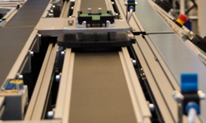
One Piece Flow Enabled by SAP in Detail
Industrie 4.0 – Aspects of One Piece Production
When production starts, each finished product that have to be produced, will be uniquely identified with the number (SFC = Shop Floor Control number) against this number all the production history for this product will be collected and stored in SAP ME system.
The finished product will be placed onto the carrier to be moved from one workstation to the next. The carrier contains RFID chip where the production information will be written, thus helping other systems or machines to understand what product is now being processed. Each work station on a conveyer is also equipped with the RFID chip to identify the moment when the product arrives and request or pass necessary information.
SFC number
for product
RFID chip
on carrier
RFID reader
at
workstation

Slide 5
One Piece Flow Enabled by SAP in Detail
Industrie 4.0 – Aspects of One Piece Production
The process starts once the demand appears (the production order is created in SAP ERP) and this demand in the form of production order is immediately transferred to the production control and execution system (SAP ME), which resides on the level below in our vertical integration model. The production order is getting released to production and contains all required information about how the product is to be manufactured, like material variant, quantity, BOM, and routing.
And the automated production process begins.
MES
MES
MES
MES
2. SAP ME selects the next scheduled order and releases for execution. The SFC number is assigned. The info about SFC, material and the next routing step is passed to work station and is written to RFID chip
4. SAP ME provides parameters to be collected and sends back to work station, after parameters are collected the SAP ME validates them and writes data to RFID.
The process is repeated at Drilling work station, but the parameters that are passed and validated are different.
6. SAP ME provides SFC components to the work station. After the assembly is done SAP ME validates the assembly and writes data to RFID chip (SFC, material and next step)
8. SAP ME provides parameters to visual workstation (camera), where visual test is executed and results passed to SAP ME.
If pass – ME sends to picking
If fail – ME sends to rework. The data is written to RFID.
Initialization (at magazine)
Magazine load
Drilling
Robot assembly
Camera check
1. The product carrier arrives, the work station identifies carries and connects to SAP ME
3. The product carrier arrives, the work station reads data from RFID and asks SAP ME for parameters.
5. The product carrier arrives, the work station reads data from RFID (SFC, material and routing step) and asks SAP ME for components to be assembled
7. The product carrier arrives, the work station reads data from RFID and asks SAP ME for test parameters

Slide 6
One Piece Flow Enabled by SAP in Detail
Industrie 4.0 – Aspects of One Piece Production
The rework are picking are both manual processes where we use some of the concepts of the Industrie 4.0 like visual aids (visualization for defects logging and picking of a proper packing box) and touch mobile User Interface (UI) for operator.
2D/3D
Visual aids
2D/3D
Visual aids
Touch /Mobile
devices
MES
Touch /Mobile
devices
MES
10. SAP ME user works in Touch POD. The POD is refreshed. The user manually logs the defect using the 2D/3D visual aids to identify the problem. If the problem is repaired, ME passes the data to workstation to return the product to regular flow. If scrapped, SFC is closed, inventory adjusted in ME and ERP and the RFID is reset.
4. SAP ME identifies packing requirements and refreshes POD with visual work instruction.
If boxing – the ME displayed required color of the box where the product has to be placed.
If immediate storage is required, the inventory adjustments are done in ME and ERP, the SFC is closed, the order completion is transferred to ERP. The RFID chip is reset.
Manual Rework
Manual packing
The product will be delivered to different customers depending on the variant.
9. The product carrier arrives, the work station identifies carries and connect to SAP ME
3. The product carrier arrives, the work station reads data from RFID and asks SAP ME for packing requirements.

Slide 7
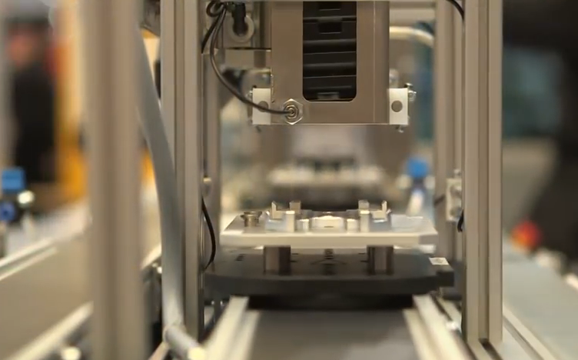
Festo Line: Initialization at Magazine
Industrie 4.0 – Aspects of One Piece Production

Slide 8
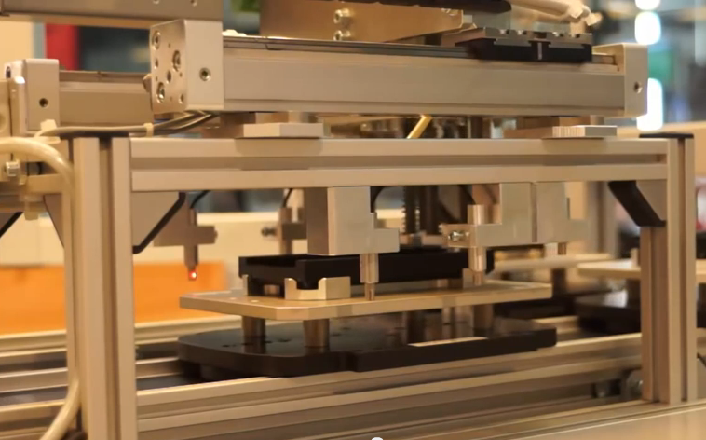
Festo Line: Drilling Left/Right Depending on the Variant
Industrie 4.0 – Aspects of One Piece Production

Slide 9
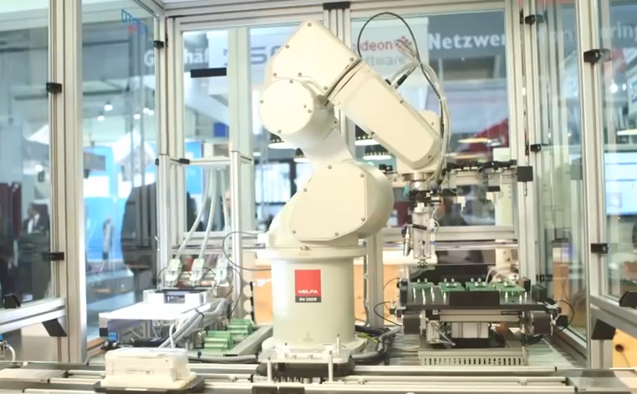
Festo Line: Assembly by Robot
Industrie 4.0 – Aspects of One Piece Production

Slide 10
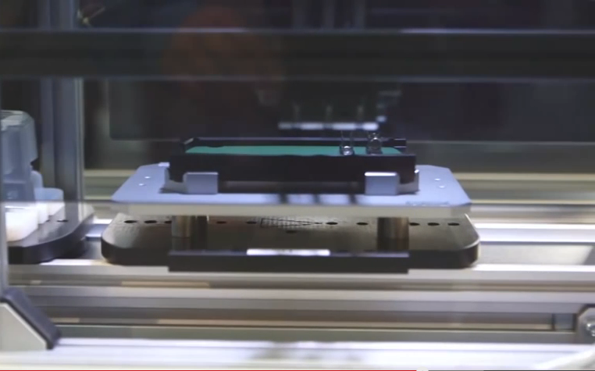
Festo Line: Camera Q-Inspection “Leakage Test”
Industrie 4.0 – Aspects of One Piece Production

Slide 11
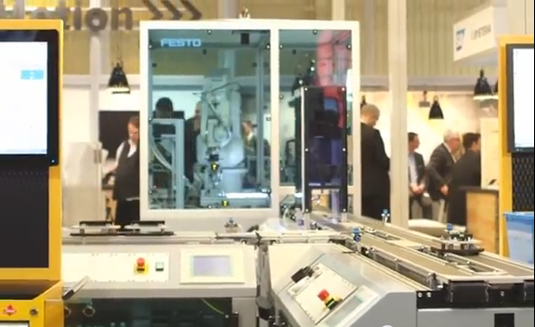
Festo Line: Switch to Either Manual Rework or Packing Stations
Industrie 4.0 – Aspects of One Piece Production

Slide 12
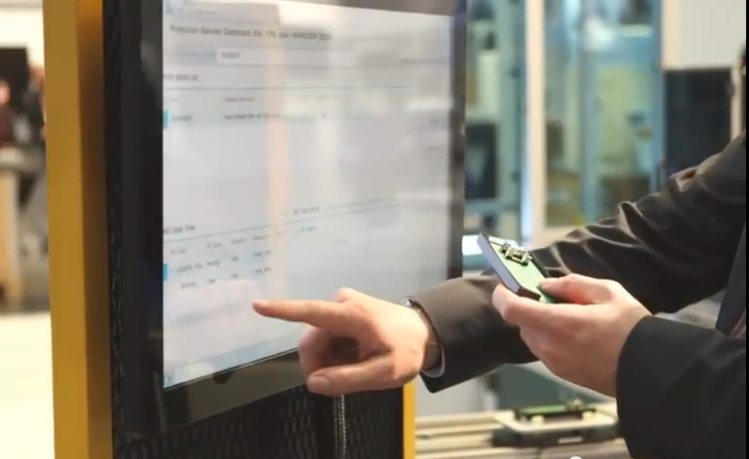
Festo Line: Manual Rework
Industrie 4.0 – Aspects of One Piece Production

Slide 13
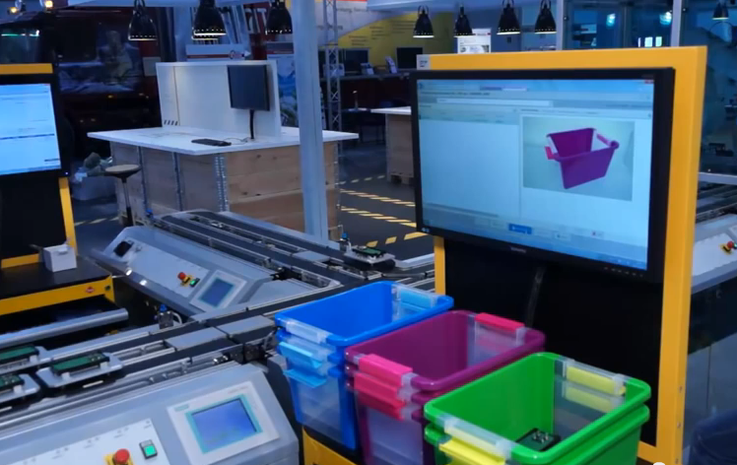
Festo Line: Manual Packing
Industrie 4.0 – Aspects of One Piece Production

Slide 14
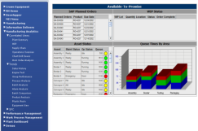
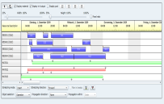
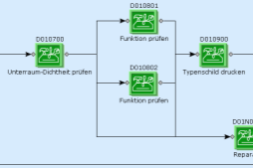
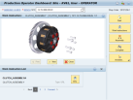
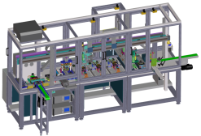
Open Integrated Factory Vertical Integration enabling lot size = 1
Industrie 4.0 – Aspects of One Piece Production
Master Data
Individual Order
ERP
Production plan
Bill of materials (BoM)
variant management
production steps
Serial Numbers
Quality results per lot
Order confirmation
Inventory update, Equipment usage
Customer Order
Production Order
ME & MII
SFC (Individual Items)
Parameters for production
Next production step
Production details mgmt
Detailed and flexible
production step routing
Shop floor controls for each step
Log parametric data
tolerance checks
Return „conformance“ or „non-conformance“ decisions
PCo
Mapping of PLC tags to ME / MII parameters
Mapping of ME production details to PLC control parameters (recipe)
Connectors
PLC (Machine)
Sensor detects material carrier
Requests control parameters from ME
Machine reports completion and requests next operation
Notes:
Pictures have to be replaced with the newer ones, especially for SFD&MT.

Slide 15
Digital Manufacturing in Xperior

